Slide 1
Terraform refresh
The terraform refresh command is used to reconcile the state Terraform knows about (the state file) with the real-world infrastructure. This is useful to ensure that the state file is up-to-date with the actual state of your resources.

Slide 2
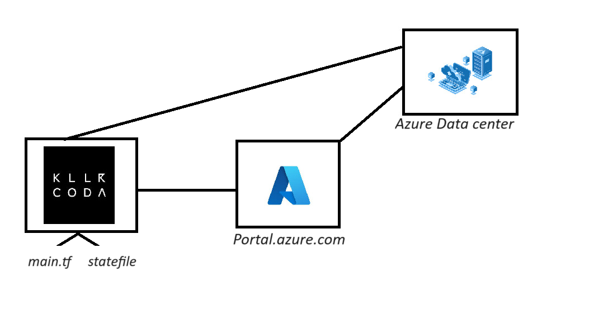

Slide 3
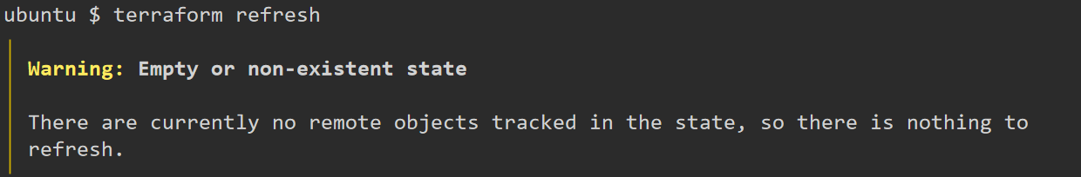
Running terraform refresh without any config

Slide 4
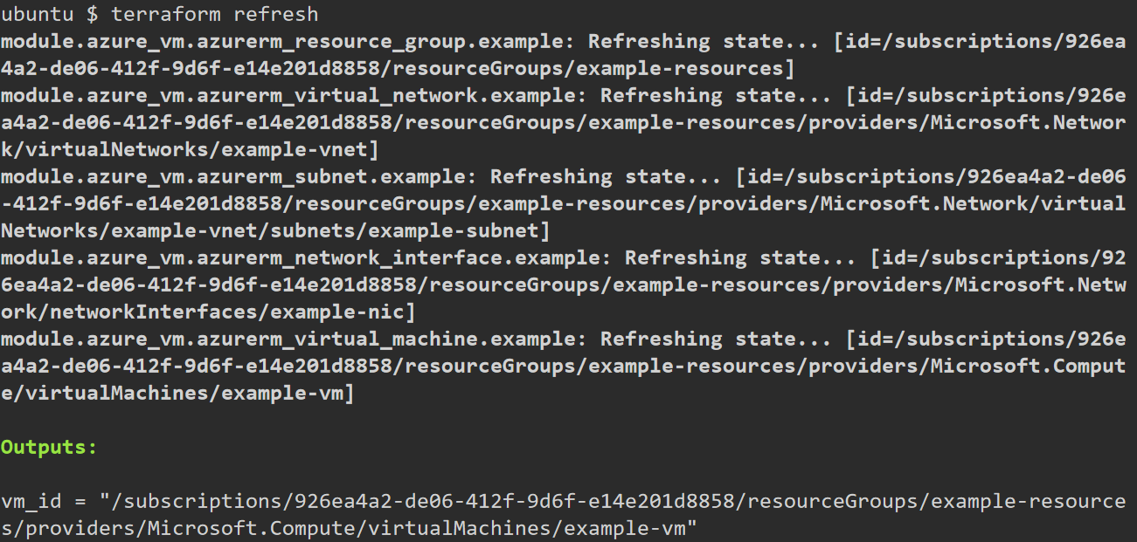

Slide 5
When to Use terraform refresh
Drift Detection: When changes are made to the infrastructure outside of Terraform (e.g., manually or through other tools).
State Updates: To update the state file with the latest resource metadata from the provider.
Pre-Plan Check: Before running terraform plan to ensure the state file is current.

